Slide 1
Understanding HTML Style Sheets

Slide 2
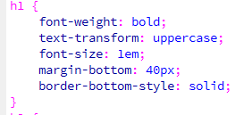
What is a style?
A style is a rule that defines the appearance and position of text and graphics. It may define the font, font size, font color, border, etc.
A style sheet is a file (css extension) that is a collection of styles that describes how to display the elements of an HTML document.

Slide 3
Three types of Style Sheets
External Style Sheets
Internal or Embedded Styles
Inline Styles

Slide 4
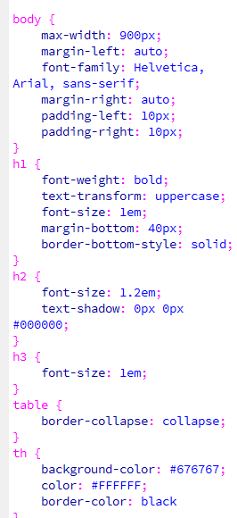
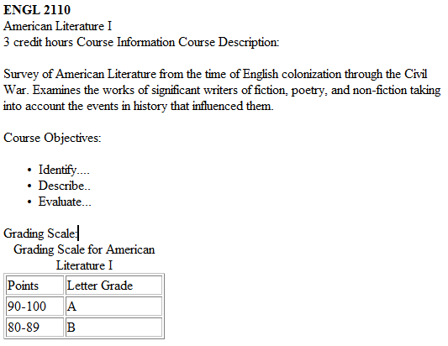
Example 1: External style sheet and HTML file
<link rel="stylesheet" type="text/css" href="https://elearn.nscc.edu/shared/Styles/D2LBasicTemplate.css" /

Slide 5
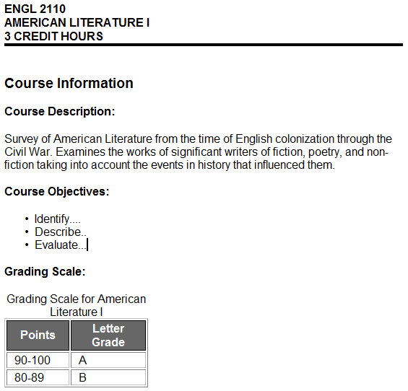
Example 1: File after the style sheet and HTML content are linked

Slide 6
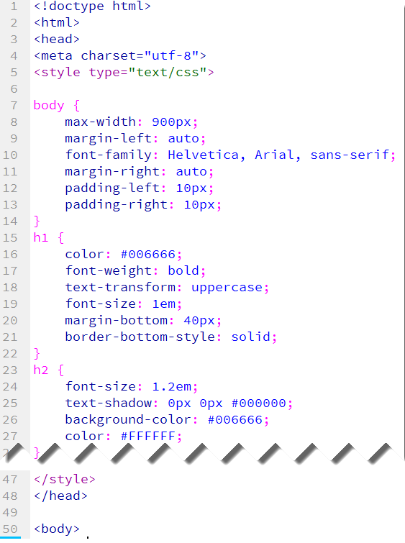
Internal or Embedded Styles
An HTML file with embedded styles is one HTML file with the styles inserted at the top of the HTML page between <head> tags.
One of the advantages is that you can move this file anywhere and the styles go with it.
Head tags

Slide 7
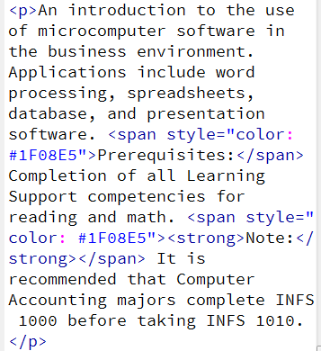
Inline Styles
An inline style is created when you format a selection of text; for example, selecting text and changing the color.

Slide 8
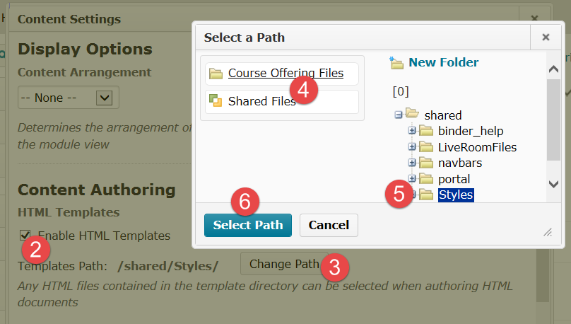
D2L Content Settings
To set D2L so you can easily locate a “document template” (stylesheet),
Go to Content and click on Settings.
Check “Enable HTML Templates.”
Choose Change Path
Select Course Offering Files or Shared Files.
Select the specific folder.
Click on Select Path.

Slide 9
Create a New File
Click on New and choose Create a File.
Enter a title.
Select a Document Template.
Key directly in the editing area or paste text.
When finished, click on Change Path to save the file in a specific folder.
Click on Publish.

Slide 10
Style Sheets in D2L
Any HTML file can be used as a template.
An HTML file with styles that is used as a template can be saved in Manage Files inside a D2L course.
There are two style sheets (HTML files with embedded styles) in the Shared Folder.
When you “Select a document template” to access a style sheet, the file is copied and saved when the file is published with the name you assign as a title. There is no “save as” feature.

